Slide 1
Irrigation System Using Soil Metrics
BECE204L
Microprocessors and Microcontrollers
Apurba Koirala- 22BCE3799
Guided by: Nisha JS

Slide 2
Contents
Introduction
Literature Review
Problem Formulation
Relevance of the problem statement
Proposed System Block Diagram/Architecture
References & Bibliography

Slide 3
Introduction
Soil quality in the hilly regions of Nepal has been deteriorating due to the lack of liming initiatives by the government. In addition, traditional irrigation methods are inefficient and often lead to water wastage. To address these issues, this project aims to design and implement an automated irrigation system that not only optimizes water usage but also helps maintain soil pH levels by adding appropriate chemical additives.
How It Works
Soil Moisture Sensors detect moisture levels in the soil.
Arduino processes sensor data and determines if irrigation is needed.
If the soil moisture level drops below a set threshold, a Relay Module activates the Water Pump to irrigate the field.
Soil pH Sensors collect data on acidity levels, which is sent to an ESP32 module for cloud storage via Firebase.
Exploratory Data Analysis (EDA) is performed on the collected soil metrics to identify acidity trends.
Based on the analysis, pH-balancing additives (such as lime or organic materials) are automatically mixed with the irrigation water to neutralize soil acidity.
By integrating real-time monitoring and automated pH correction, this system aims to improve soil health and ensure sustainable farming in Nepal’s hilly regions.

Slide 4
Literature Survey
Paper Title | Authors | Year | Key Contributions | Paper Title
Automatic Irrigation System Using Arduino UNO | K Taneja, S Bhatia | 2017 | Presented an automatic irrigation system using Arduino UNO, utilizing sensors for soil moisture and temperature to automate irrigation processes. | Automatic Irrigation System Using Arduino UNO
Design of Automatic Watering System Based on Arduino | I Prasojo, A Maseleno, N Shahu | 2020 | Developed an automatic watering system using Arduino, designed to activate irrigation based on real-time soil moisture data, ensuring water conservation and optimal plant health. | Design of Automatic Watering System Based on Arduino
Fertility Status and Dynamics of Soils in the Nepal Himalaya: A Review and Analysis | RM Bajracharya, DP Sherchan | 2009 | Reviewed soil fertility and dynamics in the Nepal Himalaya, discussing the challenges of soil fertility and its implications for agriculture in the region. | Fertility Status and Dynamics of Soils in the Nepal Himalaya: A Review and Analysis
Assessment of Soil Quality for Different Land Uses in the Chure Region of Central Nepal | P Ghimire, B Bhatta, B Pokhrel, I Shrestha | 2018 | Assessed soil quality for different land uses in the Chure region, analyzing factors like pH, organic matter, and nutrient content in relation to agricultural productivity. | Assessment of Soil Quality for Different Land Uses in the Chure Region of Central Nepal
Land Degradation by Soil Erosion in Nepal: A Review | D Chalise, L Kumar, P Kristiansen | 2019 | Reviewed land degradation caused by soil erosion in Nepal, highlighting the challenges of soil conservation and the impact of erosion on agricultural productivity in the region. | Land Degradation by Soil Erosion in Nepal: A Review

Slide 5
Problem Formulation
Soil acidity and inefficient irrigation are major issues in the hilly regions of Nepal, affecting crop productivity. Traditional irrigation leads to water wastage, while the lack of liming initiatives causes soil degradation.
To address this, we propose an automated irrigation system using soil moisture and pH sensors, Arduino, and ESP32. The system will: Optimize water use by controlling irrigation based on real-time soil moisture data. Monitor and regulate soil acidity using pH sensors and automatic chemical additives. Store and analyze soil metrics in Firebase Cloud, performing EDA to improve soil health.
This solution ensures sustainable farming by maintaining soil quality and preventing over-irrigation.

Slide 6
Relevance to SDGs
🌍 Aligned with Sustainable Development Goals (SDGs):
SDG 6: Efficient water usage and conservation.
SDG 12: Sustainable resource management.
SDG 15: Prevention of soil degradation and desertification.

Slide 7
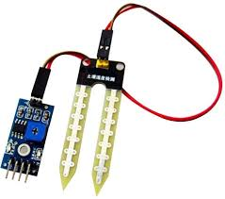
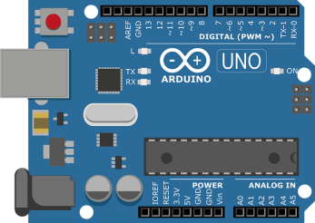
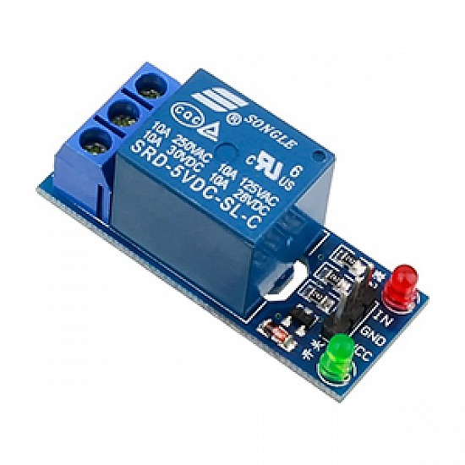
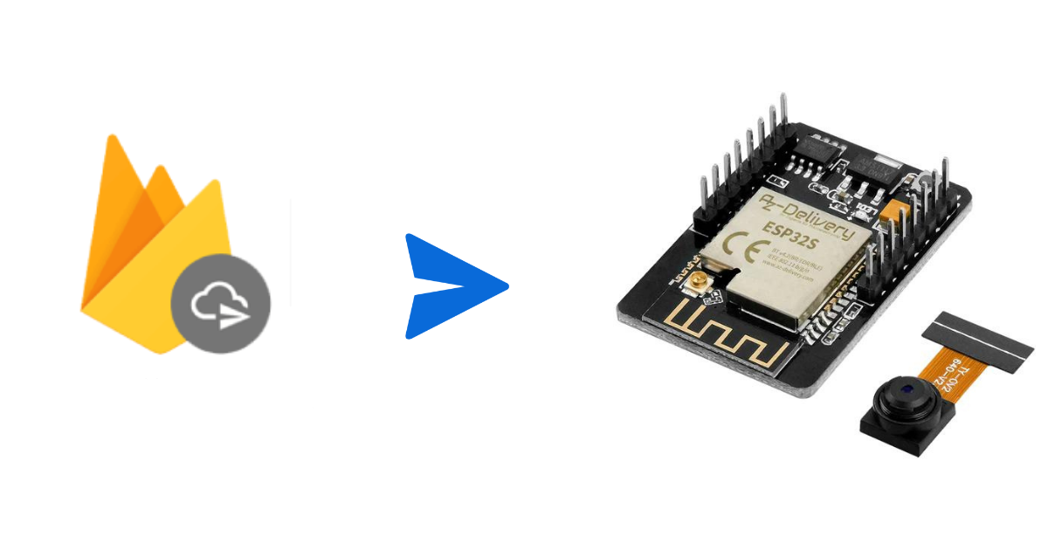
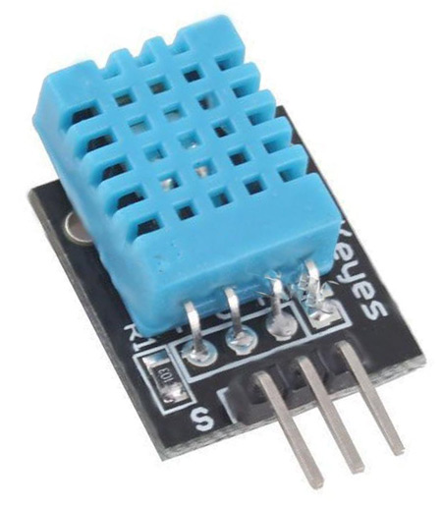
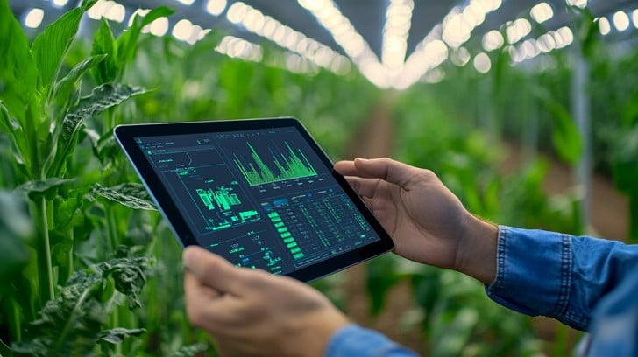
Proposed System Block Diagram
Data sent to Firebase using ESP32 WiFi Module
Relay Module
Arduino
Sensors
EDA on Soil Metrics Determination of necessary chemical additives for soil health using pH Sensor

Slide 8
References
M. Munyaradzi, B. M. Nyambo, and E. M. T. Rupere, "A Low-Cost Automatic Irrigation Controller Driven by Soil Moisture Sensors," International Journal of Agricultural Science and Technology, vol. 7, no. 3, pp. 120–128, 2019.
Y. Dong, S. Miller, and L. Kelley, "Improving Irrigation Water Use Efficiency: Using Soil Moisture Sensors," Journal of Water Resources Management, vol. 12, no. 4, pp. 456–467, 2020.
M. Dursun, "A Wireless Application of Drip Irrigation Automation Supported by Soil Moisture Sensors," IEEE Transactions on Automation in Agriculture, vol. 15, no. 2, pp. 98–105, 2011.
A. Shankar, R. Jawahar, and M. Moovendhan, "Microcontroller-Based Automatic Irrigation System Using Soil Moisture Sensor," International Journal of Embedded Systems and Applications, vol. 9, no. 1, pp. 55–64, 2015.
S. Devabhaktuni and D. V. P. Latha, "Soil Moisture and Temperature Sensor-Based Intelligent Irrigation Water Pump Controlling System Using PIC 16F72 Microcontroller," Proceedings of the International Conference on Smart Agriculture and Water Management, pp. 201–208, 2022.

